Slide 1
Impact on Entrepreneurship
Presenter:
Schaffer Grimm

Slide 2

The Startup Development
COVID IMPACTS EACH ELEMENT
Build
Team
Angels
Once aligned
OR
Need resource ($$)
Customer
Discovery
Raise
Capital
Launch Company
IDEA!
Product
Development
Venture
Capitalists
At University as long as possible

Slide 3
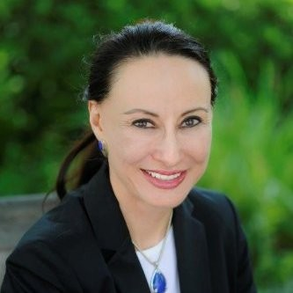

Panelists
Marla Sanchez
CFO at SensThys
George Jones
Founder of Sand Hill Angels

Slide 4
COVID Impact on Building a Team
Issues raised due to COVID
Recruitment
How do you find teammates? (Networking)
  TOUGHEST PROBLEM!
  Existing Networks
  Specialized job boards
How do you pitch them on the idea? (Pitching / showcasing / demos)
  Video interviews with applicants
  Participating in panel events

Slide 5
COVID Impact on Building a Team
Issues raised due to COVID
Company culture
How do you establish a company culture?
  Still foster team interaction
    Personnel are in the office ~ 3 days per week
    Monthly all-hands meetings (in person)
    Weekly individual / sub-team meetings
How do you know if they will fit your culture?
  Several hour on-site interview
    Chance to interact with team
    Assess culture fit

Slide 6




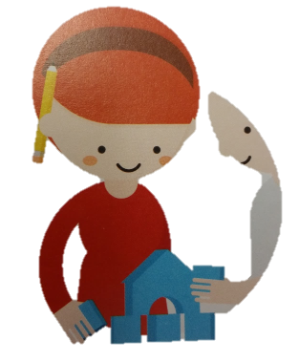
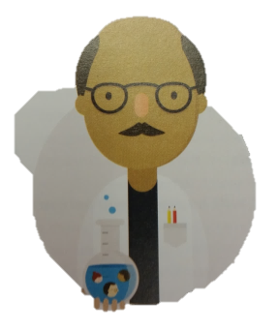
Six Techniques to Gain Customer Insights
The Data Detective
  Build on existing work with desk research.
The Journalist
  Talk to potential customers to gain customer insights.
The Anthropologists
  Observe potential customers in the real world to get good insights into how they really behave
The Impersonator
  “Be your customer” – spend a day in your customer’s shoes
The Co-creator
  Integrate customers in the process of value creation to learn with them
The Scientists
  Get customers to participate in an experiment

Slide 7
COVID Impact on Customer Discovery
Issues raised due to COVID
Finding Customers
How do you find critical customer segments to interview?
  Key customers
  Key Opinion Leaders (KOL)
  Payers, users, recommenders, etc.
Customer insights
How can you observe them?
How effectively can you interview them?

Slide 8
COVID Impact on Product Development
Issues raised due to COVID
Team Collaboration
Can you still effectively collaborate with team members on product development?
  Methods to maintain engagement:
    More scheduled meetings than normal
    Regular communication via Slack
  Seems to be working although not ideal
How does social distancing impact your time lines and schedules?
  Things move slower
  Delays occur when:
    Needing help
    Setting up a time for team member reviews
    Awaiting Slack responses

Slide 9
COVID Impact on Product Development
Issues raised due to COVID
External Collaboration
Do you need to collaborate with external parties? (Universities, companies, Testing facilities, etc.)
  Yes!
How do you modify your collaboration accordingly?
  Tough as each party has their own COVID restrictions / policies
  Policies can change quickly without notice
  Timelines are constantly updated on the fly
Are you able to secure your necessary raw materials?
  Early on not an issue
  Last 1-2 months the semiconductor parts shortage resulted in:
    Redesign to accommodate unavailable parts
    Certain parts show 6+ month lead times
    Big concern when inventory runs out

Slide 10
Raising Capital: Angels
Average Capital raised by US companies from Angels: $300k
Potential Benefits from Angels
  Connections to customers
  Industry knowledge
  Advisors
  Do not require a board seat
Potential issues
  Distractions to keep various investors informed (and ~ happy)
Angel Networks:
  Pool together accredited investors
    Share due diligence and knowledge base
  Invest individually

Slide 11
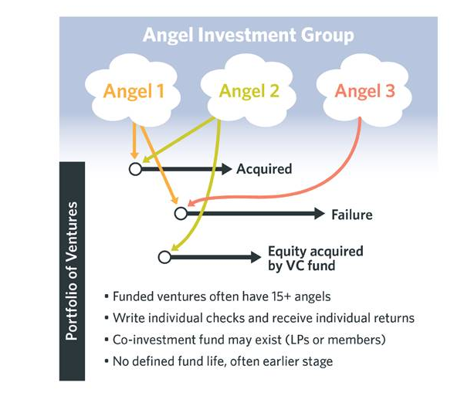
Structure of an Angel Investment Group

Slide 12
COVID Impact on Angel Networks
Issues raised due to COVID
Angles
Are Angel Networks still hosting pitch events?
Is there increased competition at pitch events?
  No longer need to be geographically located or fly in for an event
Are there fewer Angels willing to invest due to economic uncertainty?
  Reducing # of deals?
  Reducing value of deals?
  Better terms for Angels?

Slide 13
COVID Impact on Angel Networks
By the numbers:

Slide 14
COVID Impact on Angel Networks
By the numbers:

Slide 15
Raising Capital: VCs
Elements of VC investment
VCs invest in stages
  Reduces: risk, financial exposure and uncertainty
  Induces: Pressure company to hit milestones and Test management to deliver
VCs invest in syndicates
  Reduces: risk, financial exposure and uncertainty
  Collective knowledge vs. individual knowledge
Avg. $$ raised by US companies:
  1st Rd: ~ $3M

Slide 16
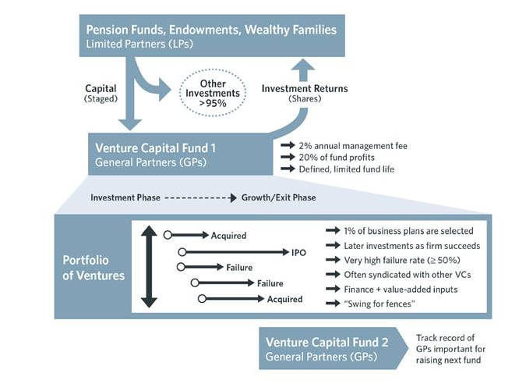
Structure of a Venture Capital Fund
Typically 5-7 years

Slide 17
COVID Impact on VCs
Issues raised due to COVID
Notes on VCs
Due to the life of their fund and need to deploy capital, still making investments
Are taking longer to make investment decisions
  Increased due diligence on companies
Using pandemic to stress test potential investment companies
  If they survive, they may be in a better state and show their strengths
Seeing a 20-25% discount on investments in companies
Holding more $ in reserve to help current portfolio companies now rather than invest in new companies
“Is the company recession proof??”
Making larger investments to provide companies with longer runway
  30-36 months (vs. standard 18-24 months)
  Does further dilute the companies

Slide 18
VC Investments 2007-2013

Slide 19
COVID Impact on VCs
By the numbers
Notes:
Unlike in 2008 – no dip in stock market – in fact higher returns on S&P 500 investments
More funds available for deals

Slide 20
COVID Impact on VCs
By the numbers
Note:
Per reports from VCs, the $ / deal has increased in 2020 and 2021

Slide 21
Ideas on how ERCs can help
Traditionally – Startups activities have been in person – no longer the case!
Limited # of startups at each ERC – Pool resources
Could the ERCs band together to form a Virtual Incubator?
  Hosting seminars?
  Creating a network to help startups find personnel?
  Hosting Investment Advisory meetings / pitch sessions?
  Provide access to unique products and services?
Solve Supply Chain issues?
  Small quantities for R&D?
  Stop gap during COVID supply shortages?
  Provide a path to scale up?

