Slide 1
ERC Perfect Pitch Contest
Contestants in the ERC Perfect Pitch Contest will pitch a problem or opportunity connected with their ERC’s strategic vision in a clear, compelling manner in 90 seconds. Contestants will use one PowerPoint slide to assist in their pitch.
Purpose of Slide:
Serve as a visual anchor to help judges remember the different pitches
Visual complement to the pitch
Format is Flexible:
Students are encouraged to be creative
Although pitch must address problem/opportunity, solution, and impact, slide content is not prescriptive
see next slide for a template highlighting the only required elements
Videos, animations, and props are prohibited

Slide 2
Short title of Perfect Pitch Project
Presenter Name, Presenter’s ERC

Slide 3
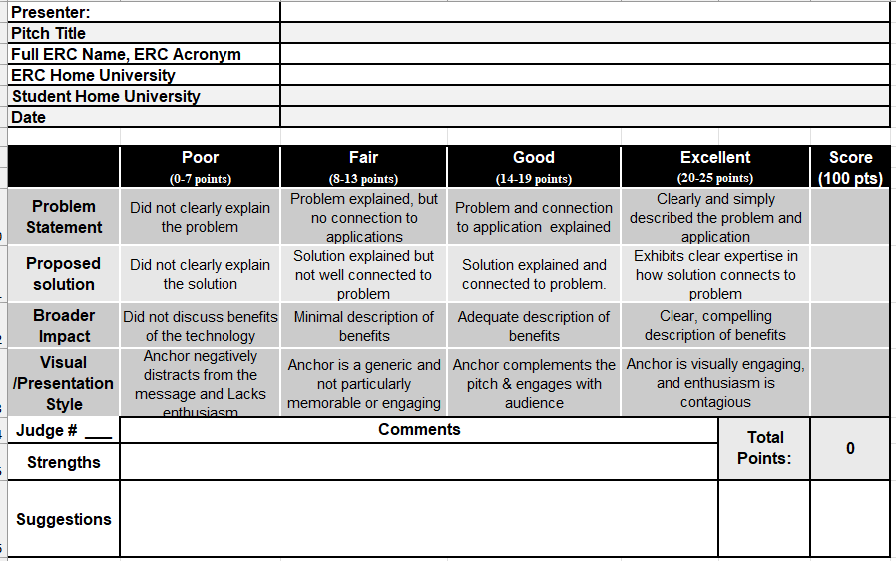
Judge Scoring sheet - 2024

Slide 4
Prize Levels
1st Prize—$5000
2nd Prize—$2000
3rd Prize—$1000
This Photo by Unknown Author is licensed under CC BY-NC

Slide 5
2024 Perfect Pitch Contest Results
The Judges will have the chance to complete the scoring online this year.
The online version is different then listed below; the content is the same.
Judges Concurrence Statement:
The assembled team of judges in the 2022 ERC-Wide Perfect Pitch Contest have discussed the merits of each presentation and concur with the average scores posted here and the final selection of the winners in this competition, as indicated in the table to the left.
ERC | Contestant Name | Judges Scores
 |  | #1 | #2 | #3 | #4 | #5 | #6 | #7 | Ave. | Rank
ERC #1 | Student #1
ERC #2 | Student #2
ERC #3 | Student #3
ERC #4 | Student #4
ERC #5 | Student #5
ERC #6 | Student #6
ERC #7 | Student #7
ERC #8 | Student #8
ERC #9 | Student #9
ERC #10 | Student #10
ERC #11 | Student #11
ERC #12 | Student #12
ERC #13 | Student #13
ERC #14 | Student #14
ERC #15 | Student #15
ERC #16 | Student #16
ERC #17 | Student #17
Judges Name | Concurrence Signature
Judge #1
Judge #2
Judge #3
Judge #4
Judge #5
Judge #6
Judge #7
Judging Instructions
Score each contestant.
Enter average score in AVE column.
Rank the top 3 and sign with judges' concurrence.
Place in envelope and seal.

