Slide 1

IAB Involvement in ERCs:
Assessing and Strengthening the Role

Slide 2
Survey Methodology
Surveymonkey used to collect and analyze data.
Separate surveys for IAB members and Center Directors.
Surveys distributed thorough center ILO’s
Responses associated with ERC Technology clusters (sub-analysis underway)
Names of respondents were not captured
Data analysis is descriptive
All data collected, along with results of today’s discussions, will be complied in a report to NSF
2012 ERC Annual Meeting

Slide 3
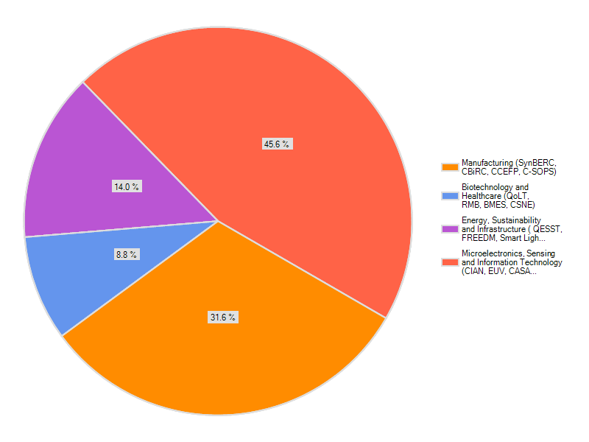
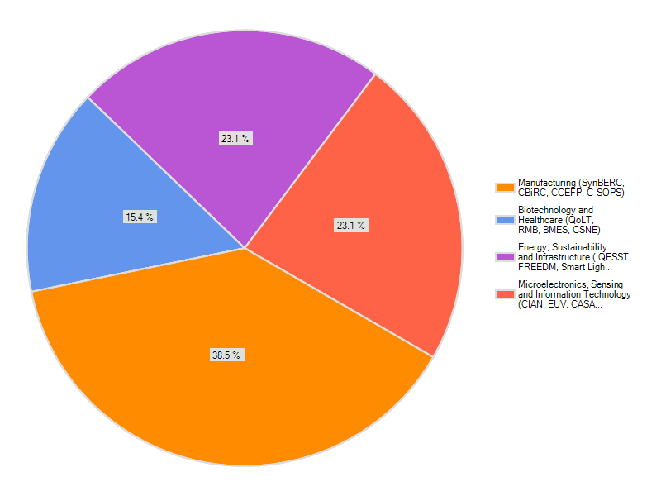

Demographics
IAB Member Responses
n = 57
Center Director Responses
n = 13
2012 ERC Annual Meeting

Slide 4
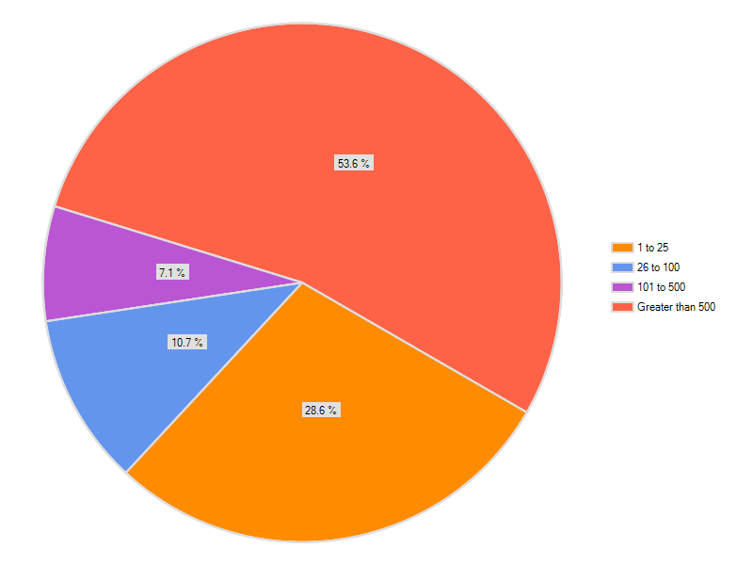
Equal Split Between Large and Small Business Respondents
n = 57
2012 ERC Annual Meeting

Slide 5

ERC – IAB Model Successes
2012 ERC Annual Meeting

Slide 6
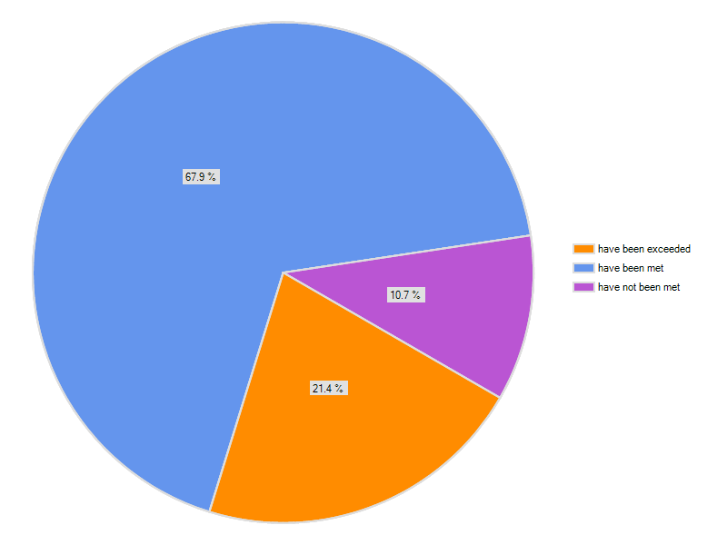
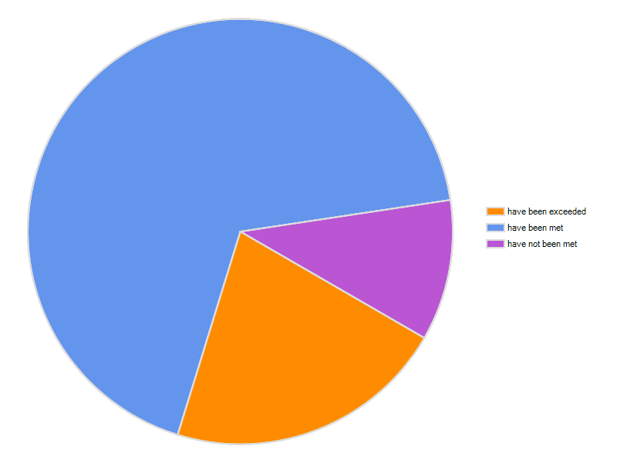
IAB Member Expectations
n = 56
2012 ERC Annual Meeting

Slide 7

IAB Model Strengths
The IAB keeps the focus on research that addresses important problems in industry. It gives industry input into how best to direct the NSF funding. I wish the NIH had similar programs.
IAB participation improves the chances that the technology will transition to industry and will be producible
2012 ERC Annual Meeting

Slide 8
IAB Model Strengths
It brings together scientists / engineers from a number of competing companies, along with the academic groups, and leverages the resources & expertise of all to advance technology.
Multidiscipinary research in a complex emerging field.
Ability to work on pre-competitive research
Less reinvestment for young researchers or students to join industry
2012 ERC Annual Meeting

Slide 9
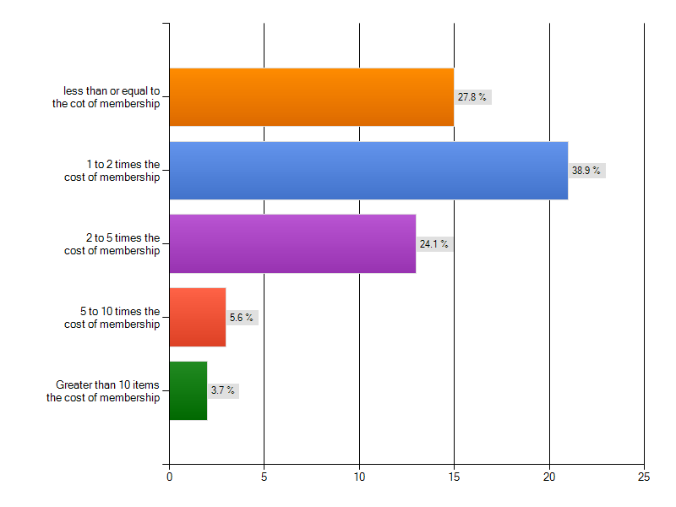
Value Returned
n = 54
2012 ERC Annual Meeting

Slide 10
Examples of Value Gained by
IAB Member Companies
Joint development activities, recruits
Our number one product has had its future direction defined by developments that have taken place within the ERC.
We found a great hire that we would probably have to have paid recruiting fees on
Secured SBIR together
2012 ERC Annual Meeting

Slide 11
IAB Membership Adds Value to Centers
Pursue small development projects to help advance/vet some premature technologies towards/for commercialization.
Support our industrial outreach efforts
Expand educational outreach and support for special ERC projects (testbed expansion)
Increase the number of students and postdocs that are funded
Hold workshops on specific topics
2012 ERC Annual Meeting

Slide 12
ERC-IAB Opportunities
Additional Avenues of Engagement?
2012 ERC Annual Meeting

Slide 13
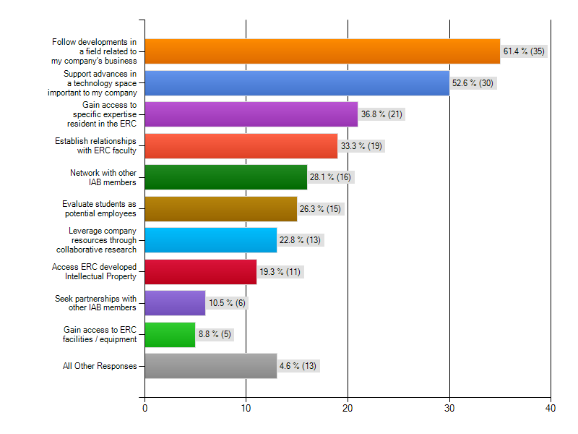
Three Most Important Factors Influencing Decision to Join IAB
n = 57
2012 ERC Annual Meeting

Slide 14
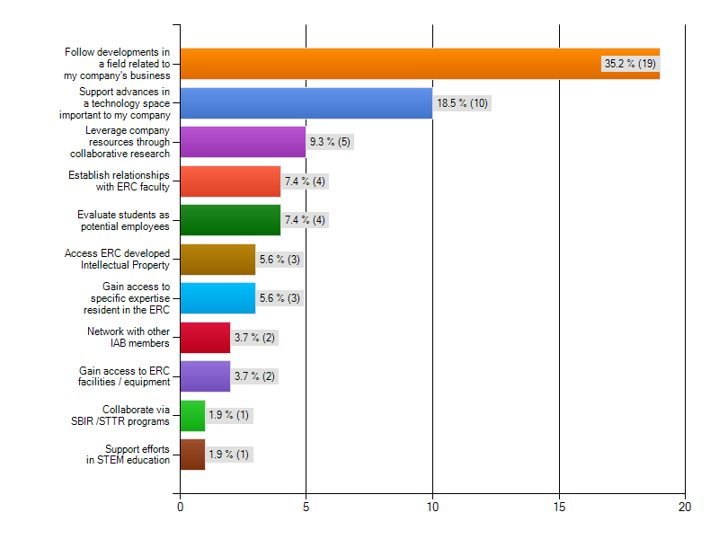
Single Most Important Factor Influencing Decision to Join IAB
n = 57
2012 ERC Annual Meeting

Slide 15
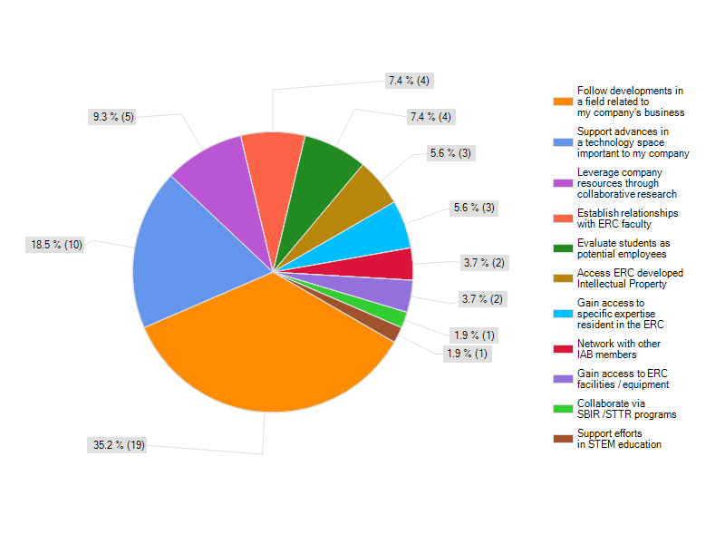
Single Most Important Factor Influencing Decision to Join IAB
2012 ERC Annual Meeting

Slide 16
Additional Opportunities for Engagement with ERC’s
Leverage Corporate Research Dollars through Collaborative Research? Project Championship?
Improved Access to IP?
Collaboration between IAB Members?
Are there barriers to these types of interactions
that that could be addressed through modifications
to the ERC-IAB Model?
2012 ERC Annual Meeting

Slide 17
ERC-IAB Opportunities
Technology Road Mapping
Center Sustainability
2012 ERC Annual Meeting

Slide 18
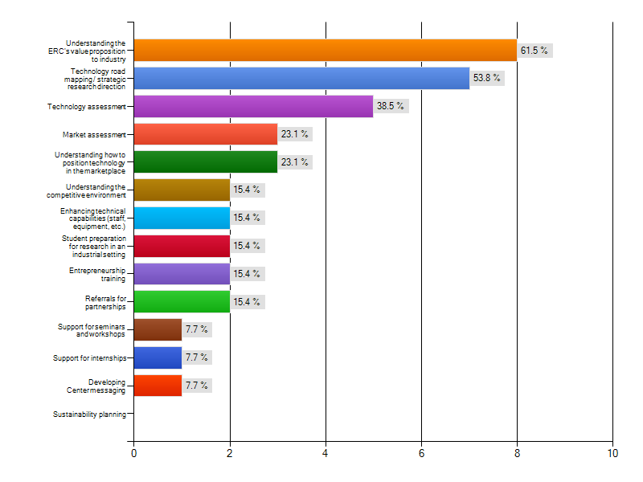
Three Areas in Which the IAB Has Added the Most Value to My Center
2012 ERC Annual Meeting

Slide 19
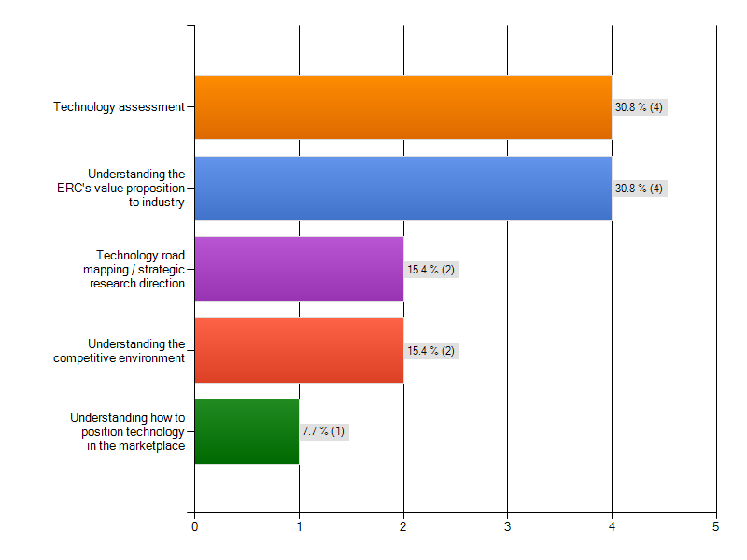
Single Area in Which IAB has Added the Most Value to My Center
n = 13
2012 ERC Annual Meeting

Slide 20
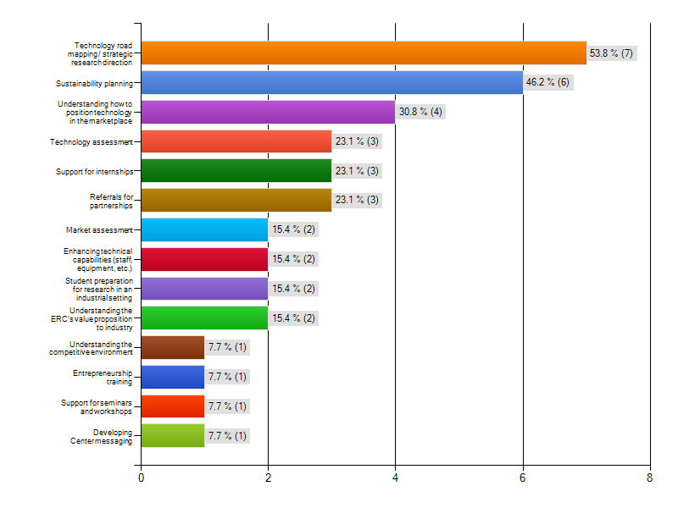
Three Most Important Areas Where Additional Guidance Would Aid ERC
n = 13

Slide 21
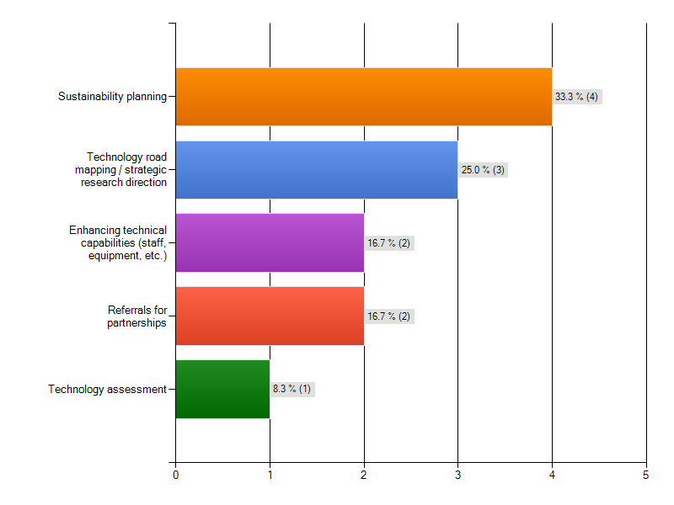
Single Most Important Area Where Additional Guidance from IAB is Needed
n = 13
n = 13

Slide 22
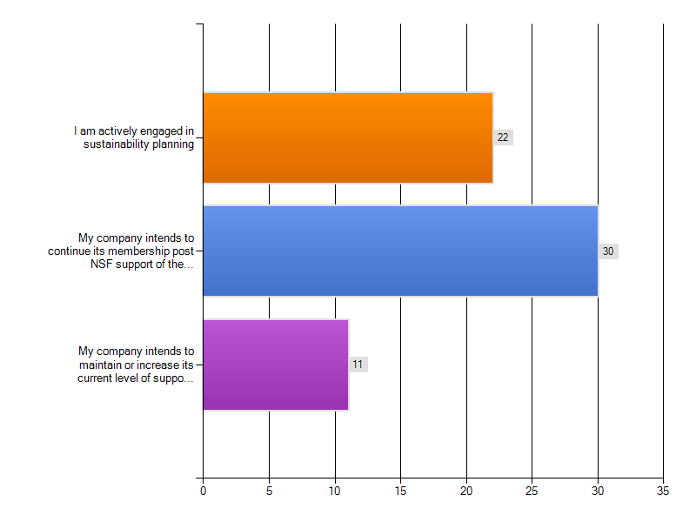
IAB and Center Sustainability
n = 50

Slide 23
Opportunities for Additional Guidance
Technology Road Mapping and Sustainability Planning:
  Timing in the life of an ERC?
  Overlap?
  Graduated Centers: Best Practices for Sustainability?
  What avenues would best provide the guidance
  that ERC Center Directors seek?
2012 ERC Annual Meeting

Slide 24
ERC-IAB Opportunities
IAB SWOT Analysis
2012 ERC Annual Meeting

Slide 25
SWOT: IAB Responses
 | Strongly Agree | Agree | Neutral | Disagree | Strongly Disagree
My contributions are valued | 38.2% (21) | 52.7% (29) | 9.1% (5) | 0.0% (0) | 0.0% (0)
The ERC is responsive to suggestions made in the SWOT | 39.6% (21) | 49.1% (26) | 11.3% (6) | 0.0% (0) | 0.0% (0)
The SWOT enhances the value of the ERC to member companies | 30.9% (17) | 50.9% (28) | 16.4% (9) | 1.8% (1) | 0.0% (0)
The SWOT results in increased focus for the ERC | 29.1% (16) | 50.9% (28) | 18.2% (10) | 1.8% (1) | 0.0% (0)
The SWOT is important in defining a path to Center sustainability | 30.9% (17) | 50.9% (28) | 16.4% (9) | 1.8% (1) | 0.0% (0)
Direct interaction with the site visit team is critical to the success of the SWOT | 34.5% (19) | 40.0% (22) | 25.5% (14) | 0.0% (0) | 0.0% (0)
2012 ERC Annual Meeting

Slide 26
SWOT: Center Director Responses
 | Strongly agree | Agree | Neutral | Disagree | Strongly Disagree
Assessing the commercial / market value of ERC technology | 15.4% (2) | 53.8% (7) | 30.8% (4) | 0.0% (0) | 0.0% (0)
Identifying potential commercial applications of ERC technology | 23.1% (3) | 38.5% (5) | 30.8% (4) | 7.7% (1) | 0.0% (0)
Determining the global competitiveness of ERC technology | 23.1% (3) | 46.2% (6) | 23.1% (3) | 7.7% (1) | 0.0% (0)
Establishing partnering strategies | 15.4% (2) | 53.8% (7) | 30.8% (4) | 0.0% (0) | 0.0% (0)
Establishing / refining research direction | 46.2% (6) | 30.8% (4) | 23.1% (3) | 0.0% (0) | 0.0% (0)
Establishing Center messaging | 23.1% (3) | 23.1% (3) | 30.8% (4) | 15.4% (2) | 7.7% (1)
Preparing students for jobs in industry | 7.7% (1) | 61.5% (8) | 23.1% (3) | 7.7% (1) | 0.0% (0)
2012 ERC Annual Meeting

Slide 27
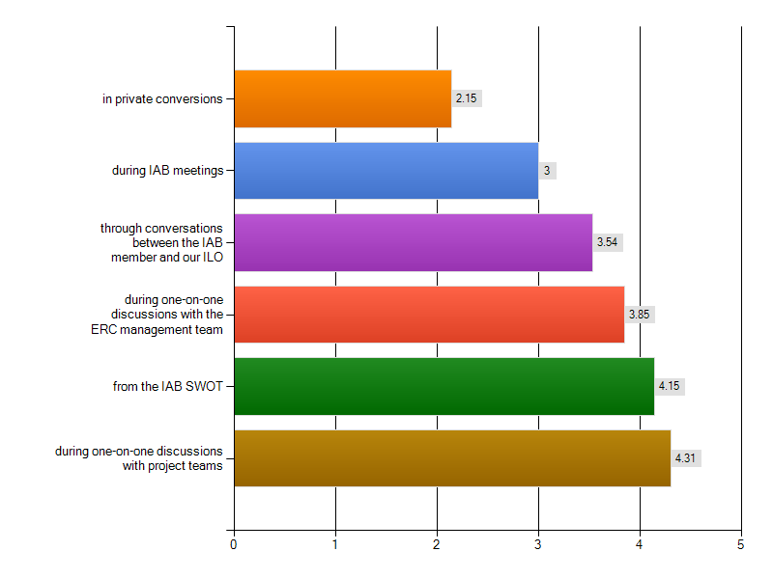
The Most Useful Guidance From My IAB Members is Provided:
Ranking: 1 to 6, with 1 being most useful
2012 ERC Annual Meeting

Slide 28
IAB Member Comments
Typically during discussions related to SWOT analyses, a group of consensus' are reached on disparate topics. Sometimes there may be two or more different views expressed on a single topic, with the group dividing into "camps". I think it is important in such cases for the SWOT analysis to make sure the ERC gets the full range of views expressed on that specific issue.
Increase site visit period to 18-24 months
2012 ERC Annual Meeting

Slide 29
Center Director Comments
SWOT too generic, would benefit from focusing on potential commercial applications of specific ERC technologies
Drop the SWOT analysis exercise
What opportunities exist to improve the
value of the IAB SWOT ? What metrics should be applied in evaluating the ERC-IAB interaction?
2012 ERC Annual Meeting

